Slide 1
Nonprofit Training
Planning Your Day of Giving Campaign

Slide 2
Today’s Agenda
The Basics
What is a Day of Giving?
Why a South Dakota Day of Giving?
Highlights from the first South Dakota Day of Giving
How it works
Create Your Campaign
3. Set Your Goals
Outline Your Communication Plan
Keep Your Donors Engaged
SD Gives Prize Pool
Wrap Up

Slide 3
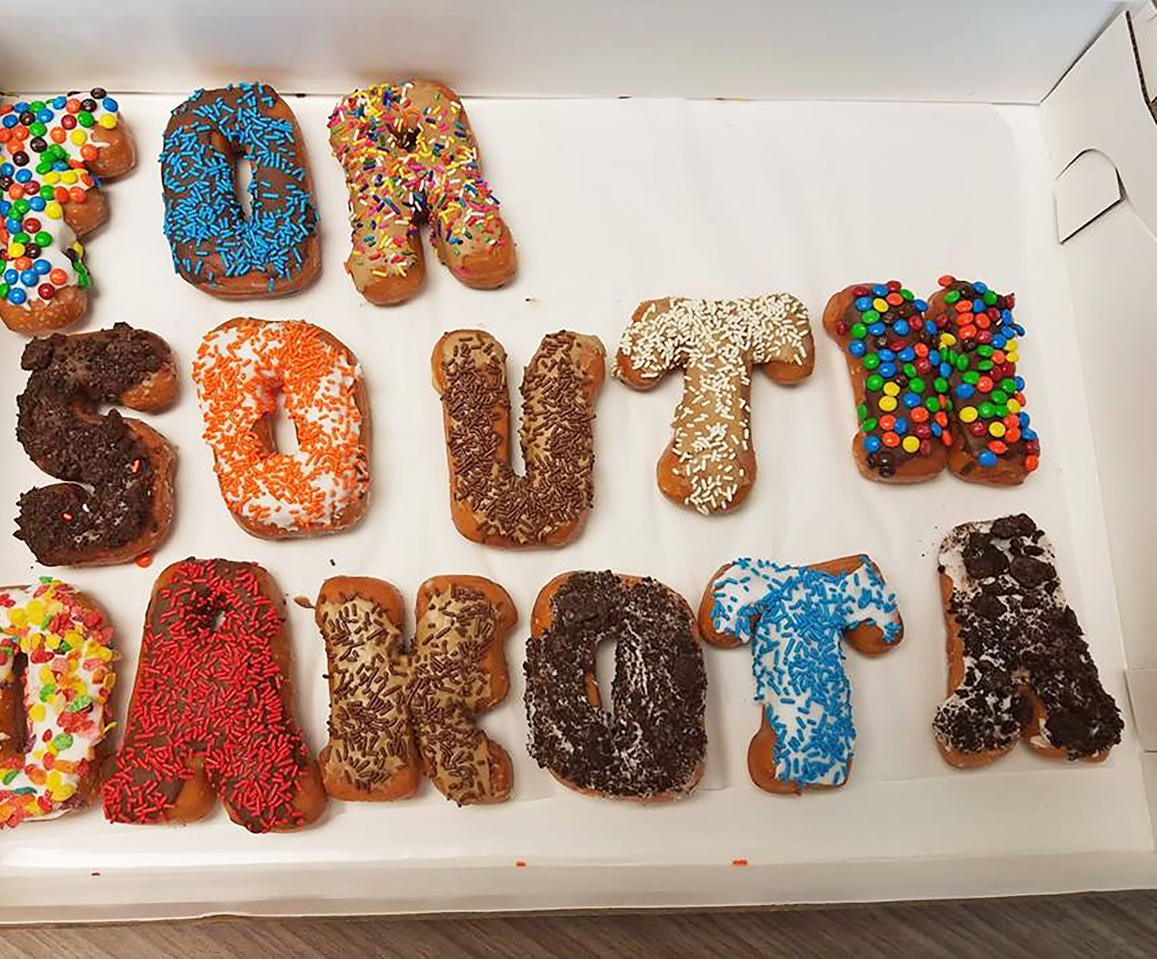
What Is A Giving Day?
#GivingTuesday
24 hour event
Benefits
Create awareness
Raise funds
Identify new donors
Grow social media following
Bring in new volunteers
Reason to engage donors/leadership
Celebrate generosity

Slide 4
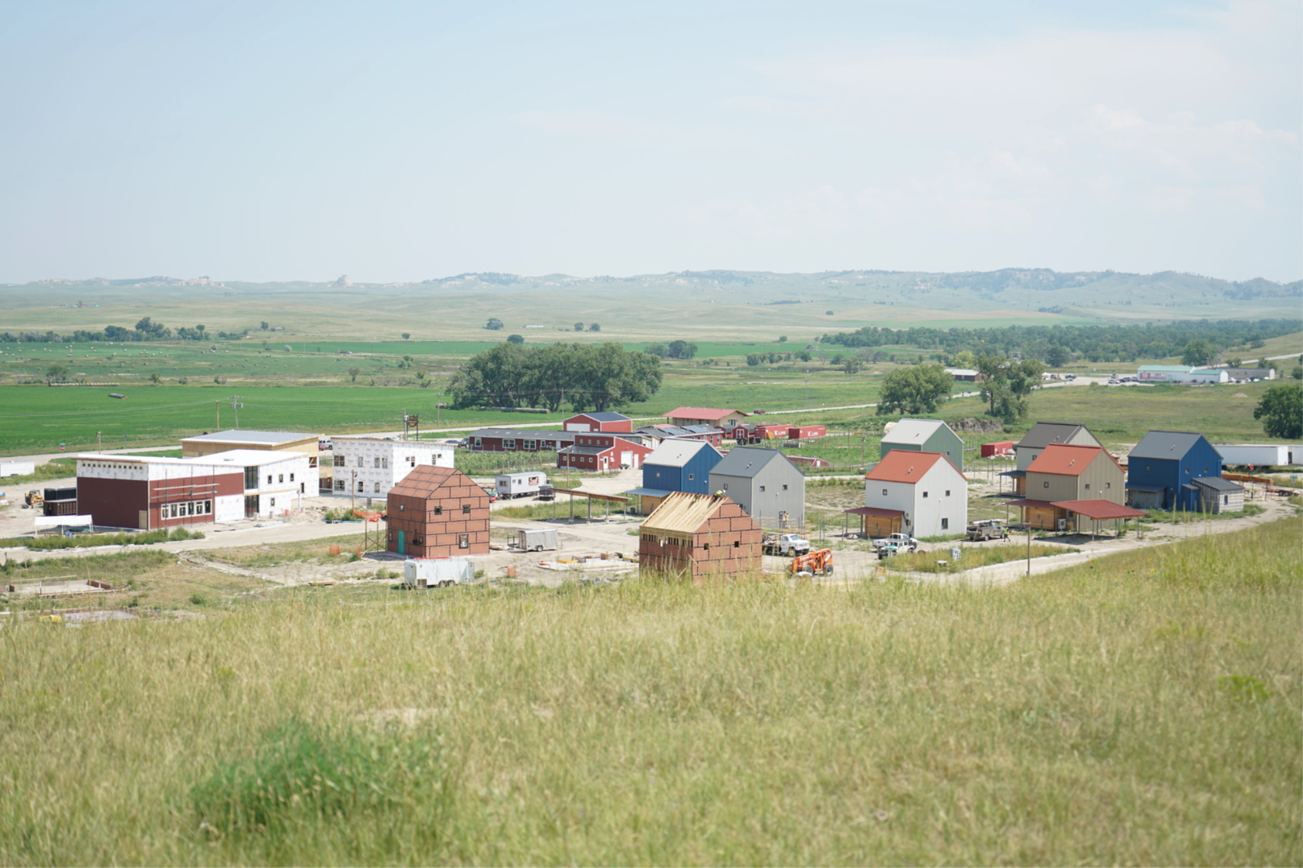
Why A South Dakota Day of Giving?
Text/image/chart
We did some research
Nonprofits are critical to South Dakota’s community life
Nonprofits are looking for new tools
Nonprofits are looking for new donors
Everyone can be a philanthropist
Its fun and different

Slide 5
Highlights from the First South Dakota Day of Giving
398 nonprofits registered to participate
$1.75million raised during the 24-hour Day of Giving period
1,368 new donors who had never contributed to a nonprofit made their first financial gift
Over half of the reporting nonprofits indicated their social and traditional media read increased significantly as a result of participating
7,024 visitors to the SD Gives website on the South Dakota Day of Giving alone;
Visitors from 49 states and 14 countries came to the website on the Day of Giving;
2,700 Facebook followers were acquired for SD Gives between July-November 2018;
81,000 people engaged through posts and shares over Facebook between July-November 2018;
2.4 million total Facebook impressions during the month of November for SD Gives;
PSAs ran on 11 stations multiple times a day for two weeks prior to the Day of Giving;
Media outlets in Sioux Falls, Kyle, Rapid City, Spearfish, Mitchell, Pierre and numerous small communities picked up South Dakota Day of Giving stories, including 42 newspaper articles.

Slide 6
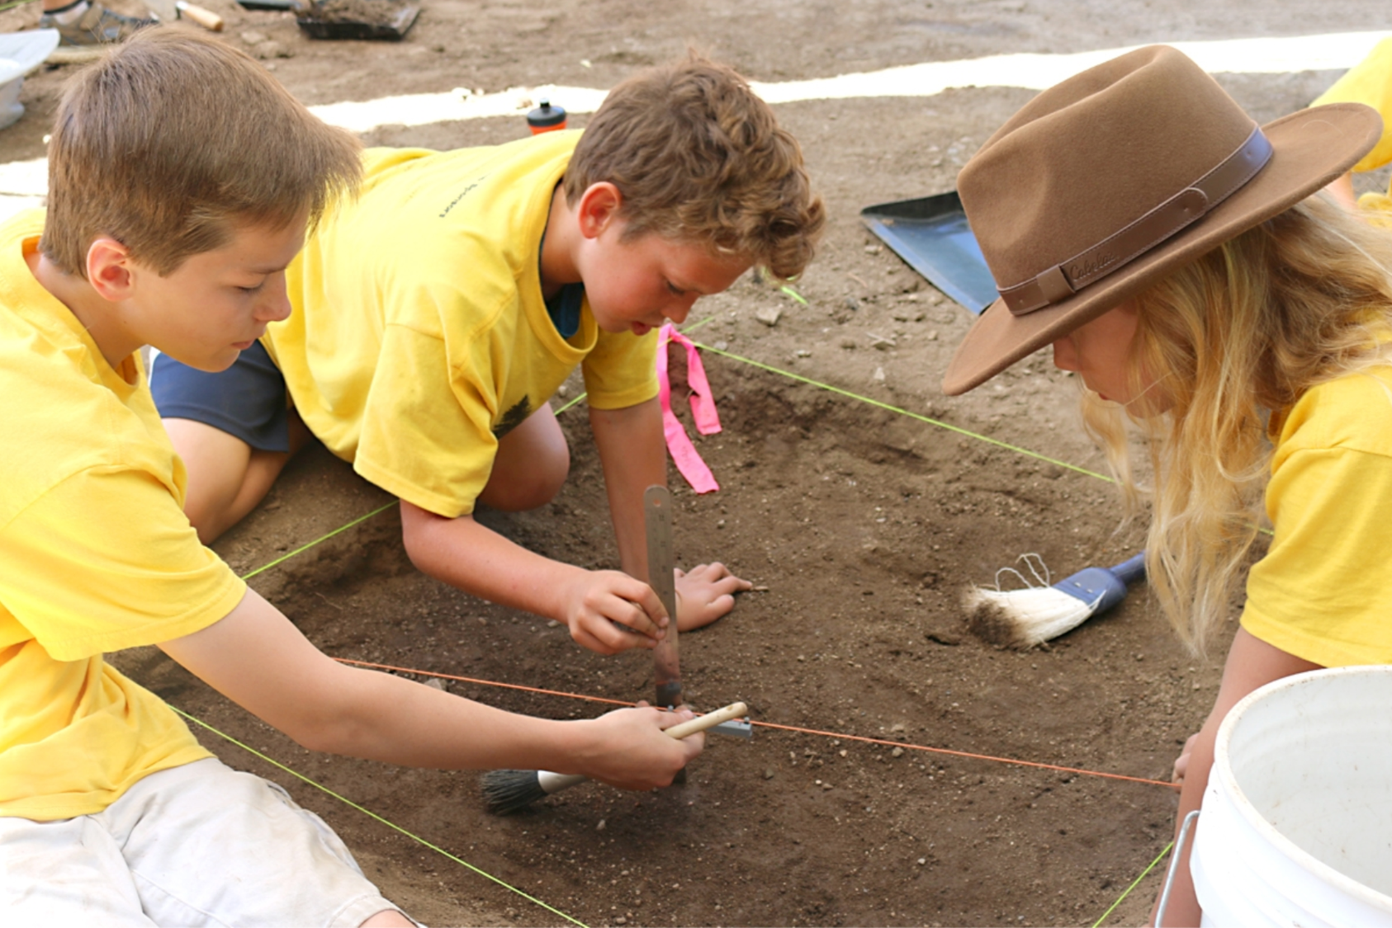
How It Works
All SD 501 c3 organizations can participate
Register to be eligible for prizes www.southdakotagives.org
All donations go directly to your organization
You engage your donors and constituents to make your day successful
Resources are available to you to download
What you can expect from SD Gives

Slide 7
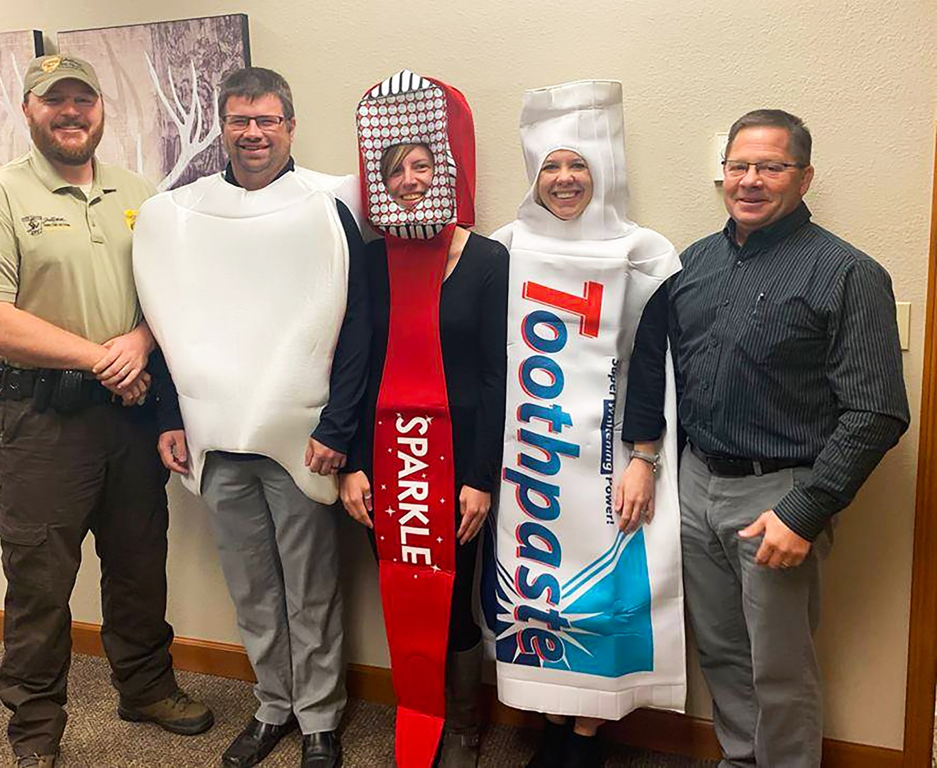
Getting Started
How do you want to use the Day of Giving tool?
Create awareness
Raise funds
Identify new donors
Grow social media following
Bring in new volunteers

Slide 8
Create Your Campaign
Identify a specific project
Tangible
Specific timeline or time sensitive
Most any donor can imagine their impact
Important to your work
What is the opportunity or challenge your project addresses?
More people to serve
Equipment is required
New need identified
More staff or volunteers required
What will help you accept the opportunity or meet the challenge?
Launch something
Build something
Bring in volunteers
Purchase something
Complete something

Slide 9
Create Your Campaign
Who is your audience?
Who might be interested in your campaign?
Past and current donors
Social media followers
Business partners
Clients
Volunteers
Board members
What might move your audience?
Who should share your message?
Board member
Client
Volunteer
What is the call to action for your audience?
How can various audiences be helpful?
Outline a number of of calls to action to use throughout the Day of Giving
Join, share something, think about something, invite, collect items, ask someone,
follow us, tweet, listen to something, watch a video, read something, resolve, post

Slide 10
Create Your Campaign
Engage your Board members and other leadership
Have a Day of Giving kickoff at next Board meeting
Include your Board in your goals and give planning updates
Provide Board members with clear opportunities to help you reach Day of Giving goals
matching funds
social sharing
promotion of your/their participation with their networks
Consider Board members for peer-to-peer fundraising to help expand your reach
Invite Board members to attend in-person events
Ask Board members to help you personally thank donors
Thank Board members for their help on Day of Giving and celebrate success

Slide 11
Set Your Goals
What do you want to accomplish with the Day of Giving Tool
Raise funds
Social media reach
Recruit volunteers
Engage media
Fully utilize a match or challenge
Board participation
Establish partnership
Goal statements include a number, an action and an audience
10 new donors will contribute $50 or more each
5 Board members will raise $300 each through their network
1 business partner will match employee giving
Raise a $2,000 matching gift
100% utilization of a $2,000 matching gift
10 new community members will register for volunteer training
Facebook followers will increase by 10%
Donations received from 50% of current donors

Slide 12
Communicate Your Campaign
Many ways to engage your audiences
Traditional
Printed newsletters, mail, postcards
Phone calls, live events, in-person visits
Onsite gatherings
Digital
Website, blogs, individual email
Bulk emails
Social media
Considerations
Where do you have a meaningful audience?
Where do your followers know to look for you?
Where do they trust hearing from you?

Slide 13
Communicate Your Campaign
May message differently with each of your audiences
Major donors, primary partners
Matching gifts opportunities
Lead and closing gift opportunities
Current donors
Make a difference
Engage in a new way
Invite someone to join you
New to you
Ask to join
Become a part of something
Help you win a prize

Slide 14
Communicate Your Campaign
Communication activities
Think of reasons to go out to your audiences
Announce participation
Introduce your campaign, provide stories and updates
Make special announcements – prize, partnerships, updates to goal
Opportunities to engage – be one of first 10 donors, helps us raise the last 5%...
Not everyone sees everything you communicate, so its ok to repeat
1-2 emails a week with calls to action
5-10 social media post with calls to action
Calls to action – Join, share something, think about something, invite someone, collect items, ask someone, follow us, tweet, listen to something, watch a video, read something, resolve, post…
Mention Day of Giving campaign in regular communications – newsletter, media interviews, volunteer events, staff communication
Make your audience a part of the campaign: solicit their stories, use their voices, and test their ideas.

Slide 15
Keep Your Donors Engaged
Continue engagement after South Dakota Day of Giving
Thank your supporters right away
Welcome new donors in a meaningful way
Share your results with your supporters. Find something to celebrate.
Use the momentum for end of year activities
1, 3, 6 month follow up plan
Have an appropriate focus on stewardship
Gift acknowledgement for donor records
Recognition for contribution
Report on what their gift made possible
Keep engaging

Slide 16
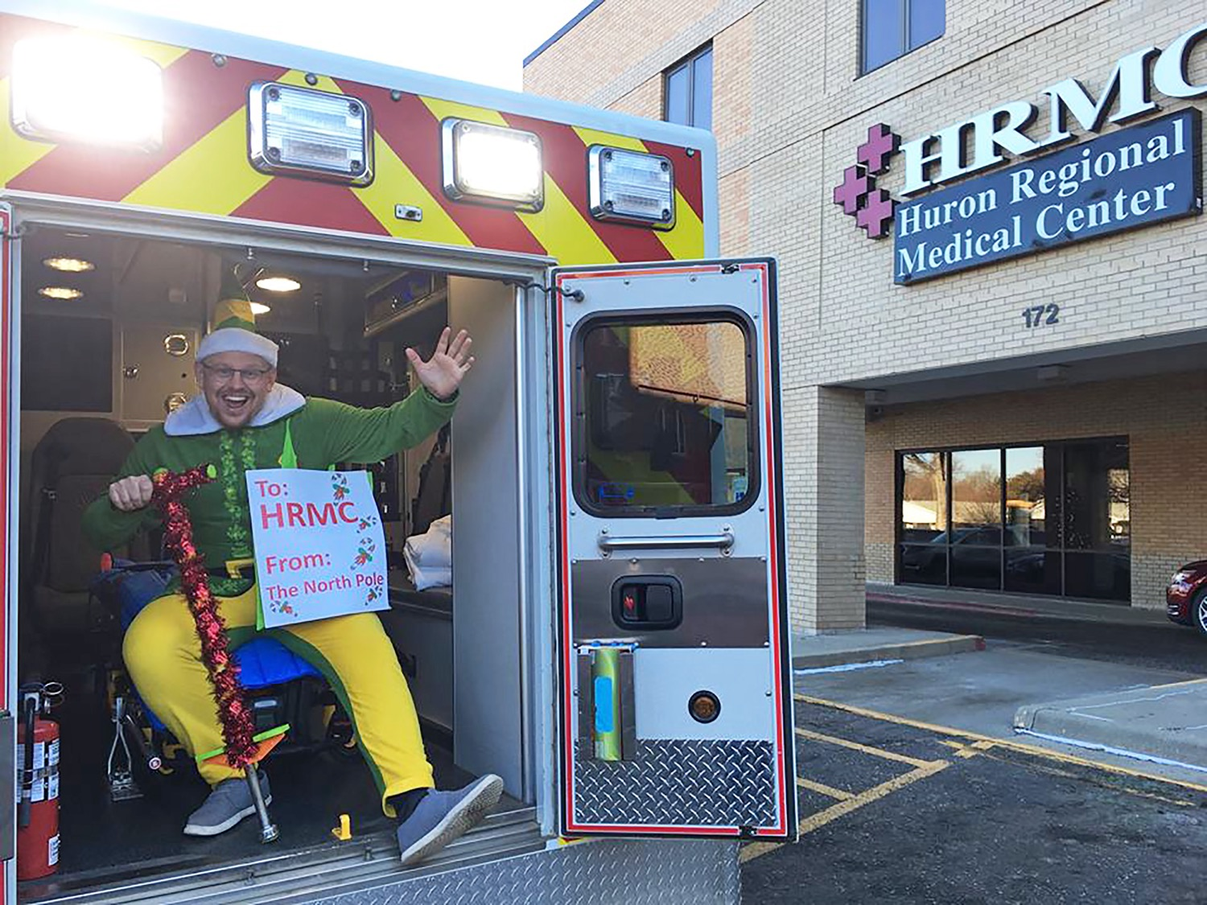
Prize Information
Think about matching and challenge gifts from within your network
Credibility
Double coupons
Look near you and ask in advance
Promote regularly

Slide 17
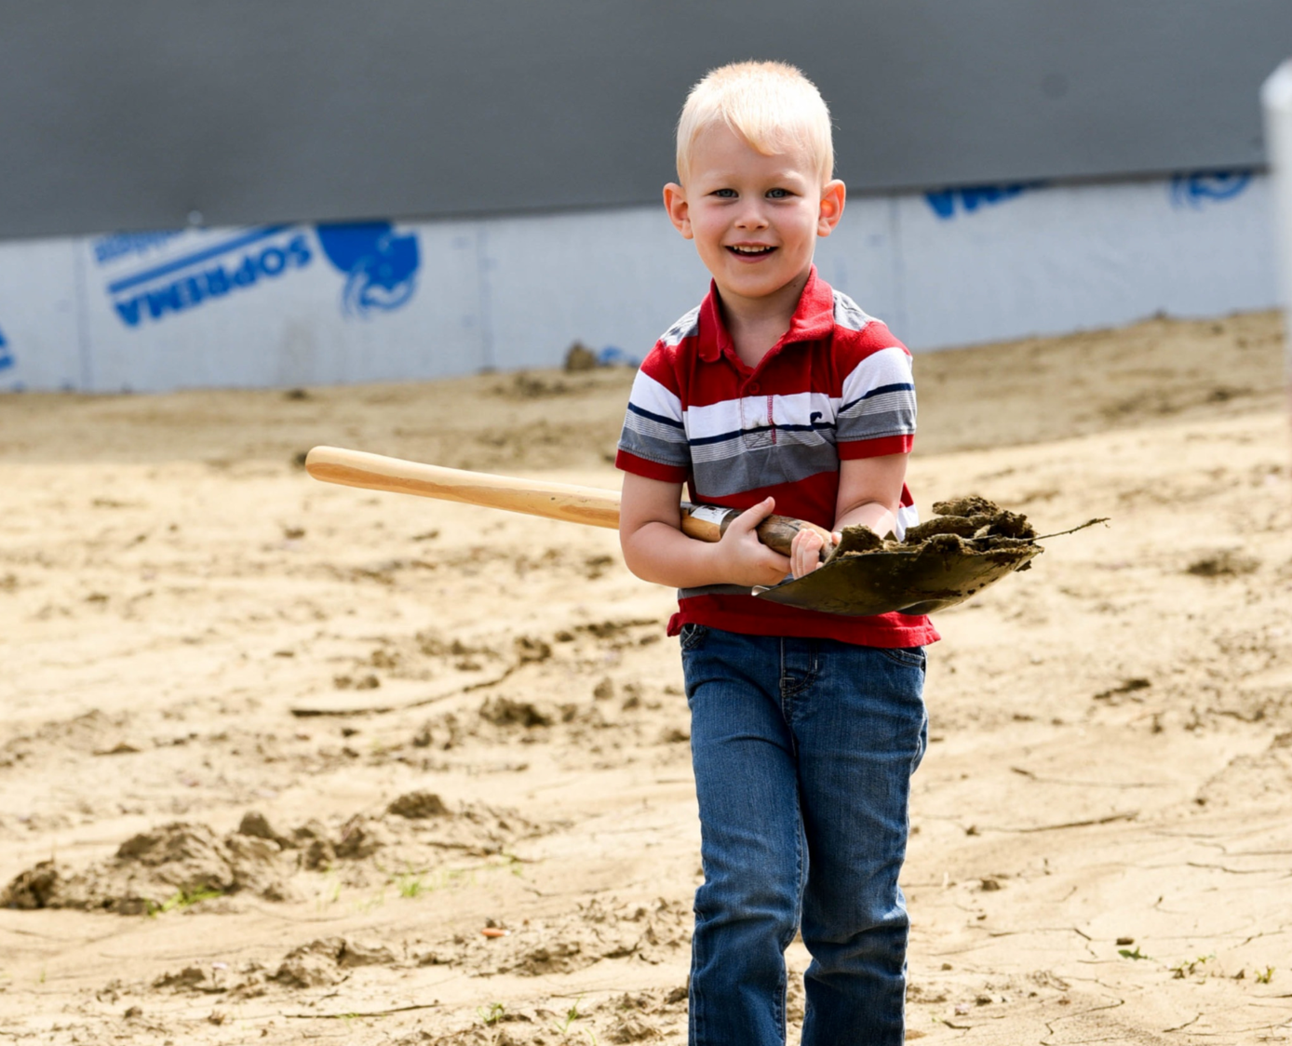
SD Gives Prize Information
Text/image/chart
Prizes will be awarded before, on and after the Day of Giving.
Some prizes are random – watch Facebook!
Consider the prizes you may want to pursue:
Board involvement
Partnerships
Videos
ALL PRIZES GIVE YOU A REASON TO ENGAGE SOMEONE IN YOUR CAMPAIGN

Slide 18
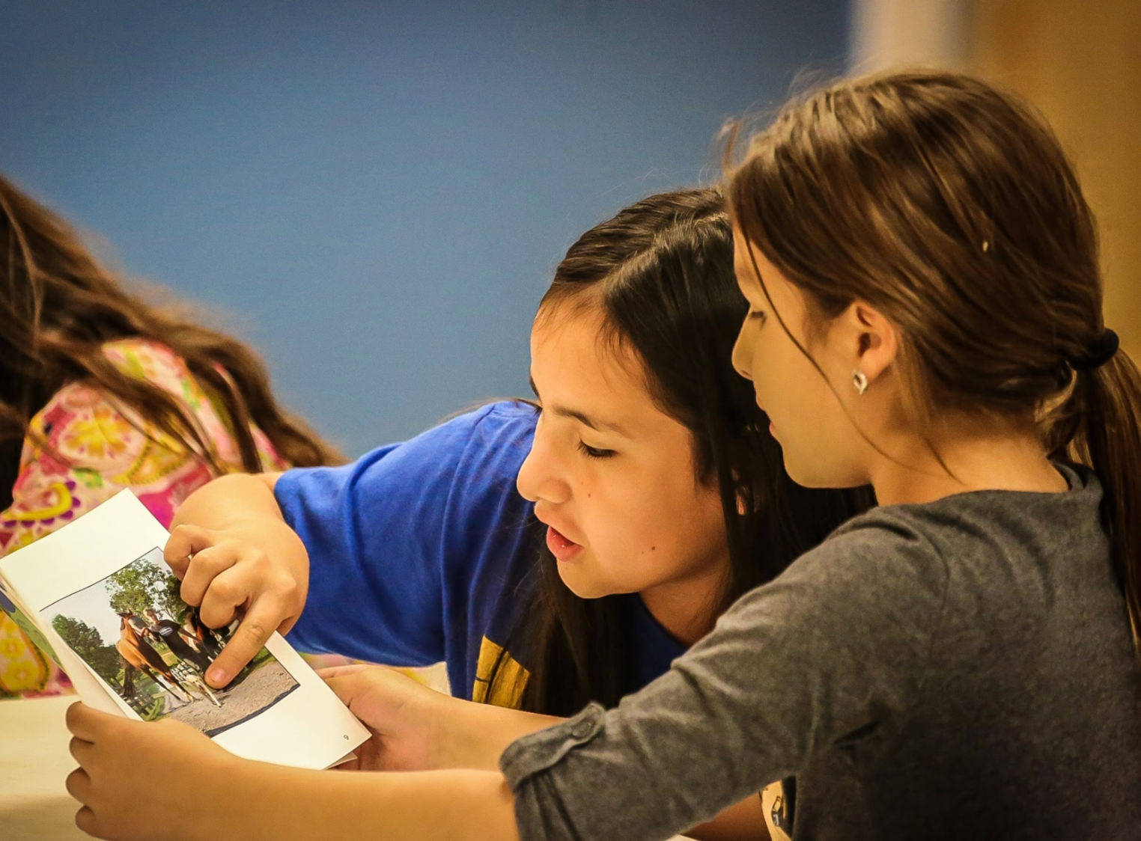
Wrap Up
Toolkit
Promotion from SD Gives
Get active on social
Get together and share your plans
Promote each other
Report on participation

